Slide 1

6TH SEMESTER - COMPUTER GRAPHICS AND VISUALISTION (18CS62) MODULE 4 3D VIEWING AND VISIBLE SURFACE DETECTION
Mr. SYED MATHEEN PASHA
ASSISTANT PROFESSOR
DEPARTMENT OF COMPUTER SCIENCE AND ENGINEERING
SAI VIDYA INSTITUTE OF TECHNOLOGY

Slide 2
Outline – Module 4
3DViewing
3D viewing concepts
3D viewing pipeline
3D viewing coordinate parameters
Transformation from world to viewing coordinates
Projection transformation
orthogonal projections
perspective projections
The viewport transformation and 3D screen coordinates
OpenGL 3D viewing functions
Visible Surface Detection Methods:
Classification of visible surface Detection algorithms,
back face detection
Depth buffer method
OpenGL visibility detection functions.

Slide 3
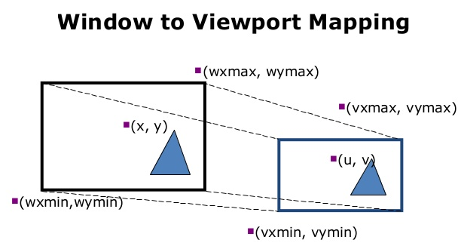
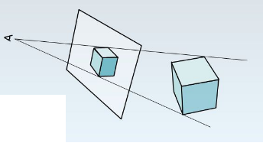
Introduction to 3D viewing
Projection is a concept it is used to mismatch 3d object coordinate representation to 2d representation

Slide 4
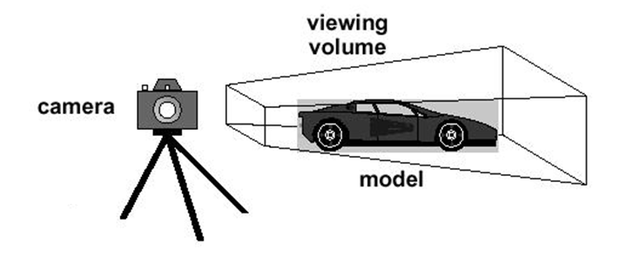
Introduction to 3D viewing
3D is just like taking a photograph!

Slide 5
3D viewing concepts
Overview of Three-Dimensional Viewing Concepts
When we model a three-dimensional scene, each object in the scene is typically defined with a set of surfaces that form a closed boundary around the object interior.
In addition to procedures that generate views of the surface features of an object, graphics packages sometimes provide routines for displaying internal components or cross sectional views of a solid object.
Many processes in three-dimensional viewing, such as the clipping routines, are similar to those in the two-dimensional viewing pipeline.
But three-dimensional viewing involves some tasks that are not present in two dimensional Viewing

Slide 6
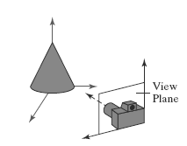
3D viewing concepts
Viewing a Three-Dimensional Scene
To obtain a display of a three-dimensional world-coordinate scene, we first set up a coordinate reference for the viewing, or “camera,” parameters.
This coordinate reference defines the position and orientation for a view plane (or projection plane) that corresponds to a camera film plane
Coordinate reference for obtaining a selected view of a three-dimensional scene

Slide 7
3D viewing concepts
Viewing a Three-Dimensional Scene
We can generate a view of an object on the output device
parallel projection
perspective projection

Slide 8
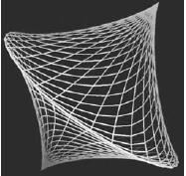
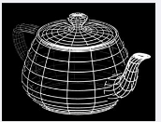
3D viewing concepts
Depth Cueing
A wire-frame object displayed with depth cueing, so that the brightness of lines decreases from the front of the object to the back

Slide 9
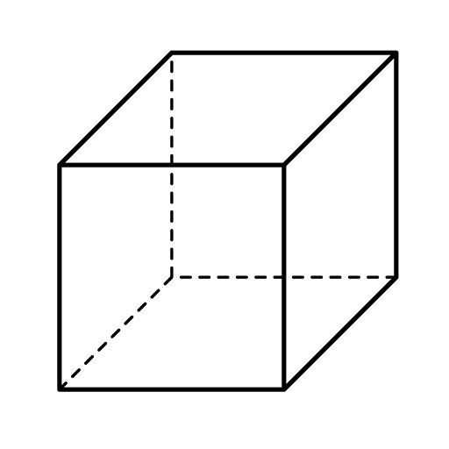
3D viewing concepts
Identifying Visible Lines and Surfaces
One approach is simply to highlight the visible lines or to display them in a different color.
Another technique, commonly used for engineering drawings, is to display the nonvisible lines as dashed lines.
Or we could remove the nonvisible lines from the display

Slide 10
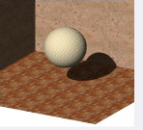
3D viewing concepts
Surface Rendering
We set the lighting conditions by specifying the color and location of the light sources, and we can also set background illumination effects.
Surface properties of objects include whether a surface is transparent or opaque and whether the surface is smooth or rough.
We set values for parameters to model surfaces such as glass, plastic, wood-grain patterns, and the bumpy appearance of an orange.

Slide 11
3D Viewing Pipeline
3D Primitives
Model Transformation
Lighting
Viewing Transformation
This is a pipelined sequence of operations to draw a 3D primitive into a 2D image for direct illumination
Projection Transformation
Clipping
Viewport Transformation
Scan Conversion
Image

Slide 12
3D Viewing Pipeline
3D Primitives
Model Transformation
Transform Model coordinates into 3d world coordinate system
Lighting
Viewing Transformation
Projection Transformation
Clipping
Viewport Transformation
Scan Conversion
Image

Slide 13
3D Viewing Pipeline
3D Primitives
Model Transformation
Transform into3d world coordinate system
Lighting
Illustrate according to lighting and reflectance
Viewing Transformation
Projection Transformation
Clipping
Viewport Transformation
Scan Conversion
Image

Slide 14
3D Viewing Pipeline
3D Primitives
Model Transformation
Transform into3d world coordinate system
Lighting
Illustrate according to lighting and reflectance
Viewing Transformation
Transform into 3D viewing coordinate system
Projection Transformation
Clipping
Viewport Transformation
Scan Conversion
Image

Slide 15
3D Viewing Pipeline
3D Primitives
Model Transformation
Transform into3d world coordinate system
Lighting
Illustrate according to lighting and reflectance
Viewing Transformation
Transform into 3D viewing coordinate system
Projection Transformation
Transform into 2D viewing coordinate system
Clipping
Viewport Transformation
Scan Conversion
Image

Slide 16
3D Viewing Pipeline
3D Primitives
Model Transformation
Transform into3d world coordinate system
Lighting
Illustrate according to lighting and reflectance
Viewing Transformation
Transform into 3D viewing coordinate system
Projection Transformation
Transform into 2D viewing coordinate system
Clipping
Clip primitives outside window’s view
Viewport Transformation
Scan Conversion
Image

Slide 17
3D Viewing Pipeline
3D Primitives
Model Transformation
Transform into3d world coordinate system
Lighting
Illustrate according to lighting and reflectance
Viewing Transformation
Transform into 3D viewing coordinate system
Projection Transformation
Transform into 2D viewing coordinate system
Clipping
Clip primitives outside window’s view
Viewport Transformation
Transform into viewport
Scan Conversion
Image

Slide 18
3D Viewing Pipeline
3D Primitives
Model Transformation
Transform into3d world coordinate system
Lighting
Illustrate according to lighting and reflectance
Viewing Transformation
Transform into 3D viewing coordinate system
Projection Transformation
Transform into 2D viewing coordinate system
Clipping
Clip primitives outside window’s view
Viewport Transformation
Transform into viewport
Scan Conversion
Draw pixels(includes texturing, hidden surface etc.)
Image

Slide 19
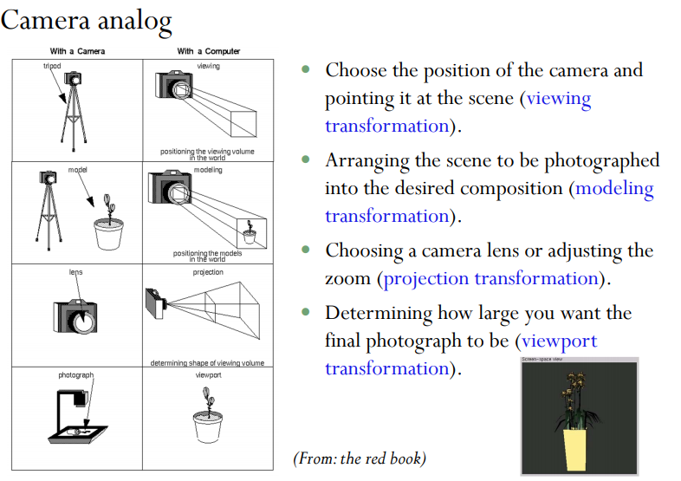

Slide 20
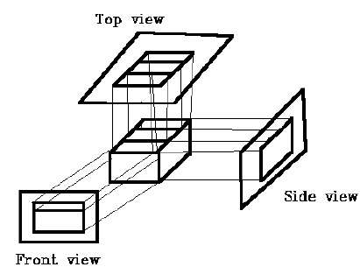
3D viewing coordinate parameters
View
View plane(Film plane in camera which should be placed at a some position, from which a shot can be obtained )
“look at” point

Slide 21
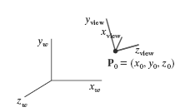
3D viewing coordinate parameters
Position
Eye position

Slide 22
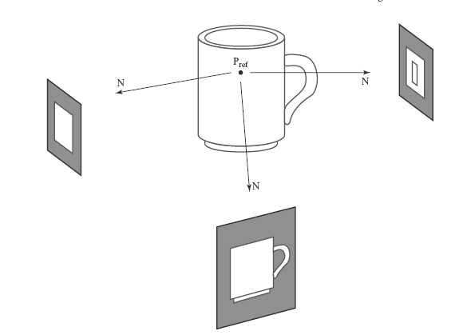
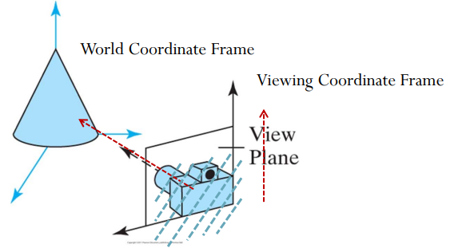
3D viewing coordinate parameters
View Reference point
Select view plane
To got a shot of the screen

Slide 23
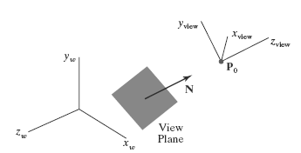
3D viewing coordinate parameters
Normal vector
Normal vector should be perpendicular to the view plane
Orientation of the view plane, as well as the direction for the positive zview
axis, can be defined with a view-plane normal vector N,

Slide 24
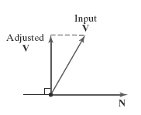
3D viewing coordinate parameters
The View-Up Vector
Once we have chosen a view-plane normal vector N, we can set the direction for the view-up vector V.
This vector is used to establish the positive direction for the yview axis.

Slide 25
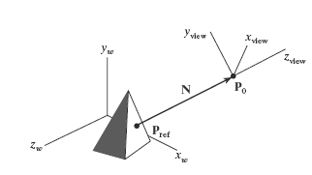
3D viewing coordinate parameters
Viewing distance(R)
Distance between the object view reference point and view plane

Slide 26
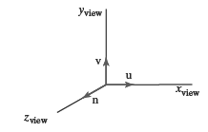
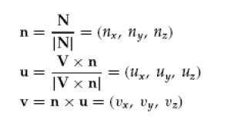
3D viewing coordinate parameters
The uvn Viewing-Coordinate Reference Frame
The coordinate system formed
with these unit vectors is often
described as a uvn viewing-
coordinate reference frame

Slide 27
Transformation from world to viewing coordinates
3D Primitives
Model Transformation
Transform into3d world coordinate system
Lighting
Illustrate according to lighting and reflectance
Viewing Transformation
Transform into 3D viewing coordinate system
Projection Transformation
Transform into 2D viewing coordinate system
Clipping
Clip primitives outside window’s view
Viewport Transformation
Transform into viewport
Scan Conversion
Draw pixels(includes texturing, hidden surface etc.)
Image

Slide 28
Transformation from world to viewing coordinates
P(x, y, z)
3D Object Coordinate
3D Viewing Coordinate
Model Transformation
3D World Coordinate
Viewing Transformation
3D Viewing Coordinate
Projection Transformation
3D Object Coordinate
2D Projection Coordinate
Viewport Transformation
3D World Coordinate
2D Device Coordinate
p(x’, y’)

Slide 29
Transformation from world to viewing coordinates
P(x, y, z)
3D Object Coordinate
Model Transformation
3D World Coordinate
Viewing
Transformation
Viewing Transformation
3D Viewing Coordinate
Projection Transformation
2D Projection Coordinate
Viewport Transformation
2D Device Coordinate
p(x’, y’)

Slide 30
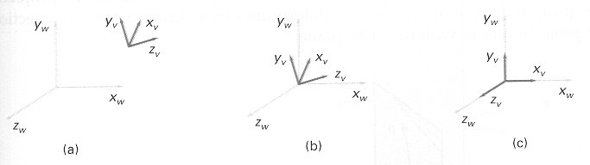
Transformation from WC to VC
Transformation sequences
1. Translate the view reference point to the origin of the WC system
2. Apply rotations to align the x_{v}, y_{v}, and z_{v} axes with the world x_{w}, y_{w},and z_{w} axes, respectively.

Slide 31
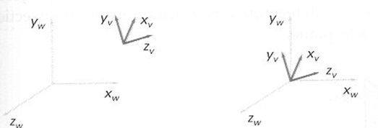
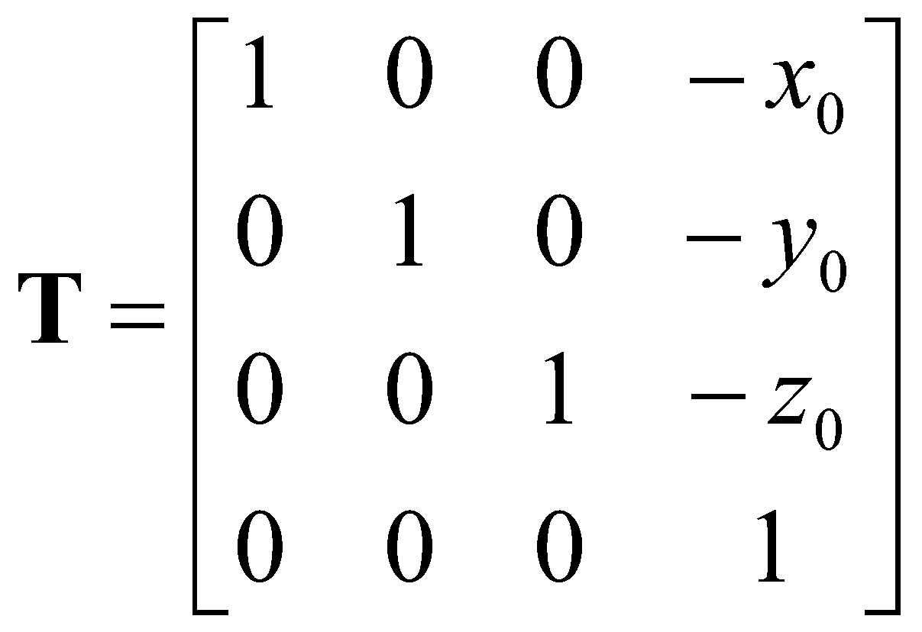
Transformation from WC to VC
Transformation sequences
Translate the view reference point to the origin of the WC system
view reference point(x₀, y₀, z₀)

Slide 32
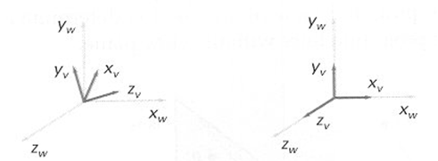
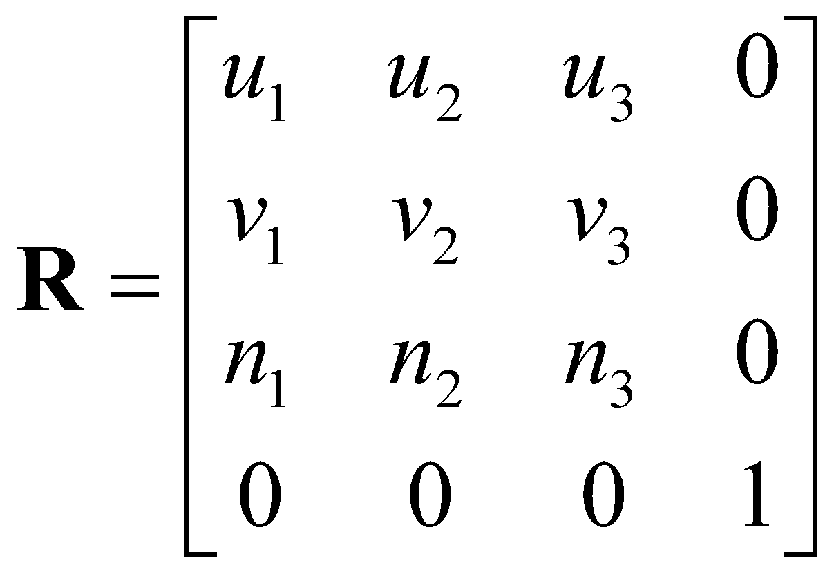
Transformation from WC to VC
Rotation
rotate around the world x_{w} axis to bring z_{v} into the x_{w}z_{w} plane
rotate around the world y_{w} axis to align the z_{w} and z_{v} axis
final rotation is about the z_{w} axis to align the y_{w} and y_{v} axis

Slide 33
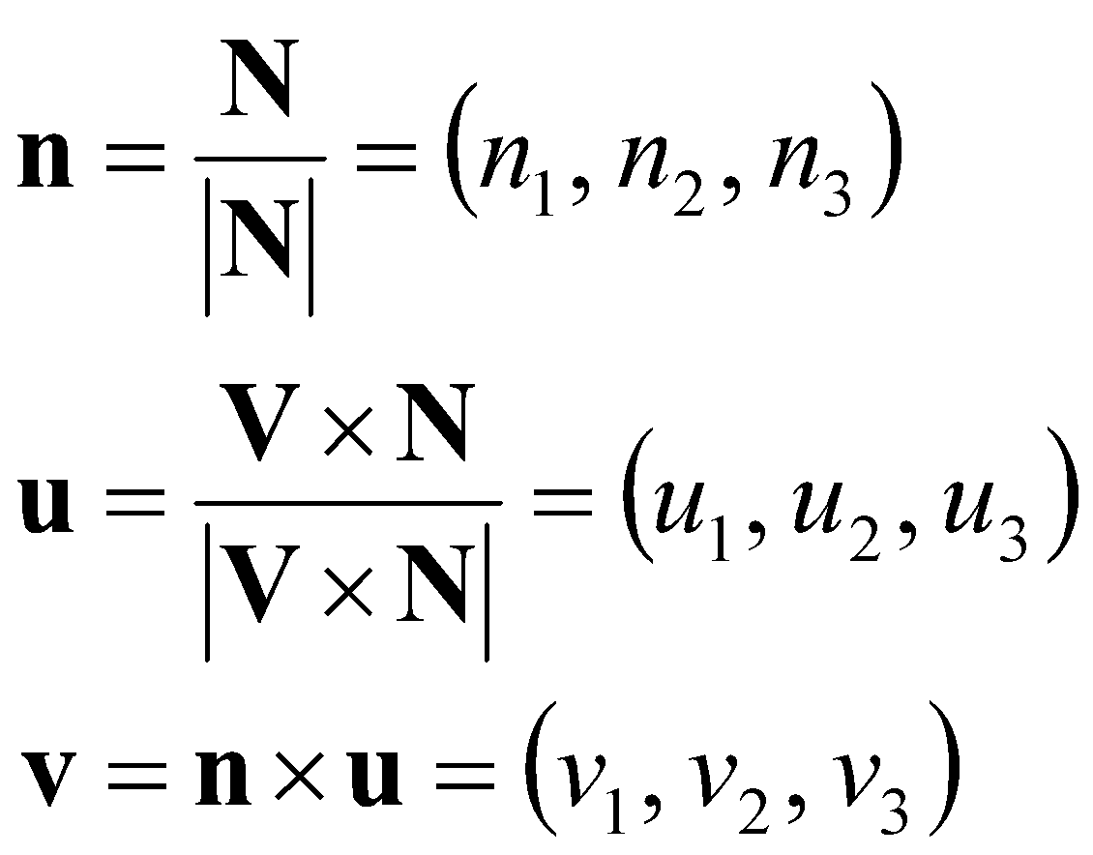
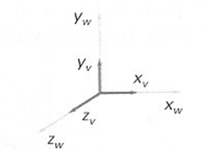
Transformation from WC to VC
Rotation by uvn system
Calculate unit uvn vectors
N : view-plane normal vector
V : view-up vector
U : perpendicular to both N and V

Slide 34
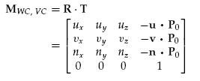

Transformation from WC to VC
The coordinate transformation matrix is then obtained as the product of the preceding translation and rotation matrices:

Slide 35
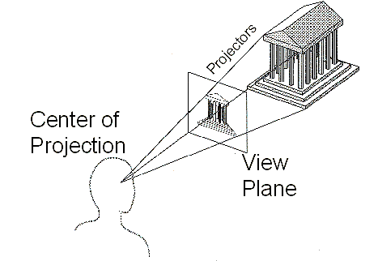
Projection
Projection in computer graphics means the transformation of a three-dimensional (3D) area into a two-dimensional (2D) area.

Slide 36
Taxonomy of Projections
Planar geometric projection
Parallel
Perspective
Orthographic
Oblique
One-point
Three-point
Two-point
Top
Axonometric
Cabinet
Other
Front
Cavalier
Side

Slide 37
Projection Transformations
Graphics packages generally support two types of projections.
Parallel projection
Perspective projection

Slide 38
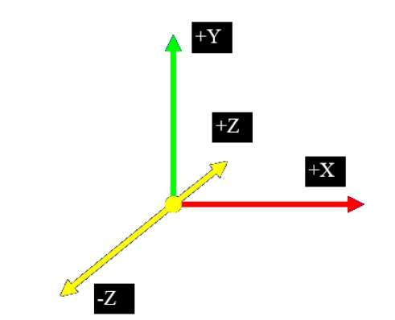

Slide 39
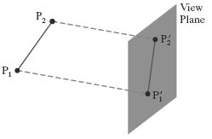
Parallel projection
Is a projection of an object in 3D space onto a fixed plane (View plane/projection plane), where the rays, known as lines of sight or projection lines, are parallel to each other.
Parallel projection discards z-coordinate and parallel lines from each vertex on the object are extended until they intersect the view plane.
In parallel projection, we specify a direction of projection (DOP)instead of center of projection(COP).

Slide 40
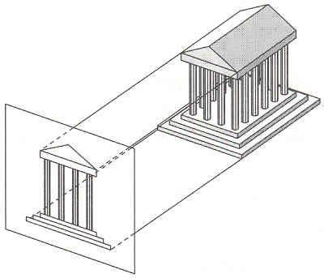
Parallel projection
A parallel projection preserves relative proportions of objects
Example : Used in computer aided drafting and design to produce scale drawings of three-dimensional objects.

Slide 41
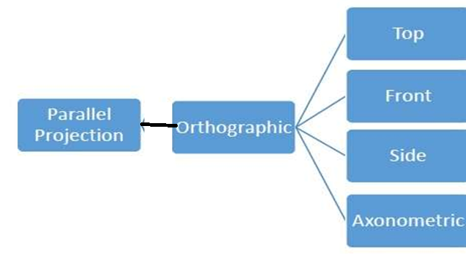
Isometric

Slide 42
Orthogonal Projections
In orthographic projection the direction of projection is normal to the projection of the plane.
There are three types of orthographic projections
Front Projection
Top Projection
Side Projection

Slide 43
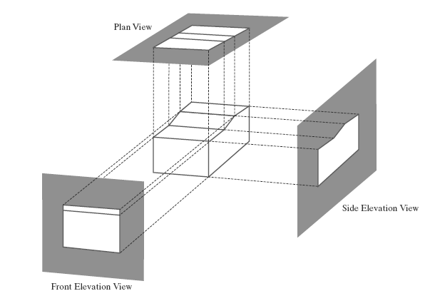
Orthogonal Projections
Orthogonal projections are most often used to produce the front, side, and top views of an object
Front, side, and rear orthogonal projections of an object are called elevations; and a top orthogonal projection is called a plan view

Slide 44
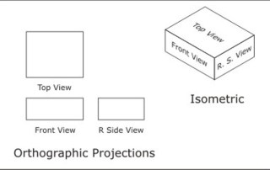
Axonometric Orthogonal Projections
Orthographic projections that show more than one side of an object are called axonometric orthographic projections..

Slide 45
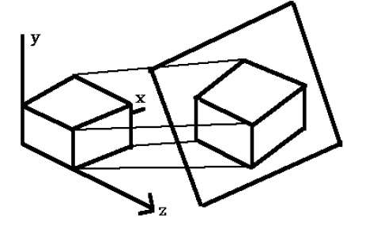
Isometric Orthogonal Projections
Isometric projection
Here projection plane intersects each coordinate axis in the model coordinate system at an equal distance.
In this projection parallelism of lines are preserved but angles are not preserve

Slide 46
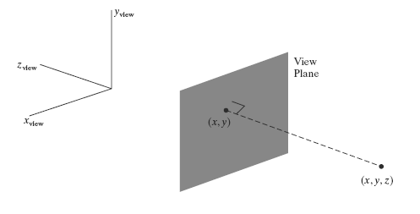
Orthogonal Projection Coordinates
With the projection direction parallel to the zview axis, the transformation equations for an orthogonal projection are trivial.
For any position (x, y, z) in viewing coordinates, as in
Figure below, the projection coordinates are
xp = x, yp = y

Slide 47
Clipping Window and Orthogonal-Projection View Volume
In OpenGL, we set up a clipping window for three-dimensional, by choosing two-dimensional coordinate positions for its lower-left and upper-right corners.

Slide 48
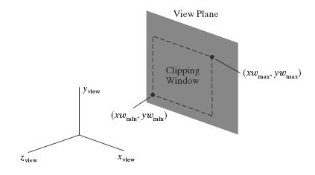
Clipping Window and Orthogonal-Projection View Volume
For 3D viewing, the clipping window is positioned on the view plane with its edges parallel to the x_{view} and y_{view} axes, as shown in Figure below .

Slide 49
Clipping Window and Orthogonal-Projection View Volume
The edges of the clipping window specify the x and y limits for the part of the scene that we want to display.
These limits are used to form the top, bottom, and two sides of a clipping region called the orthogonal-projection view volume.

Slide 50
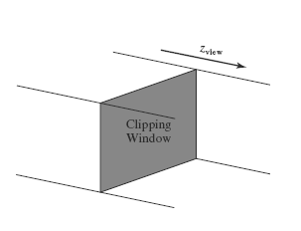
Clipping Window and Orthogonal-Projection View Volume
Projection lines are perpendicular to the view plane, these four boundaries are planes that are also perpendicular to the view plane and that pass through the edges of the clipping window to form an infinite clipping region, as in Figure below.

Slide 51
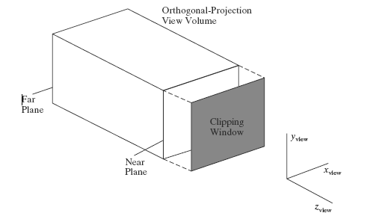
Clipping Window and Orthogonal-Projection View Volume
These two planes are called the near-far clipping planes, or the front-back clipping planes.
When the near and far planes are specified, we obtain a finite orthogonal view volume that is a rectangular parallelepiped, as shown in Figure below along with one possible placement for the view plane

Slide 52
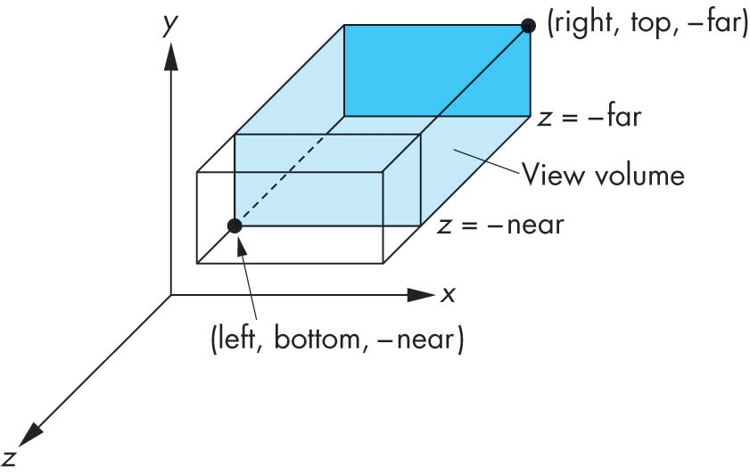
glOrtho
glOrtho(GLdouble left,GLdouble right,GLdouble bottom, GLdouble top,GLdouble zNear,GLdouble zFar);
Left The coordinates for the left vertical clipping plane.
right The coordinates for the right vertical clipping plane. bottom The coordinates for the bottom horizontal clipping plane. top The coordinates for the top horizontal clipping plans.
zNear The distances to the nearer depth clipping plane. This distance is negative if the plane is to be behind the viewer.
zFar The distances to the farther depth clipping plane. This distance is negative if the plane is to be behind the viewer

Slide 53
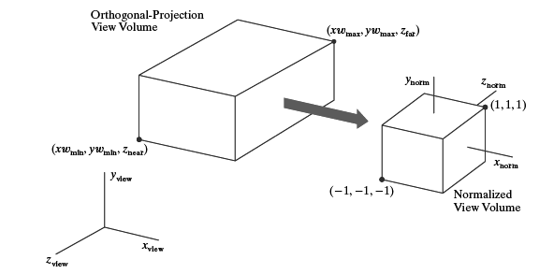
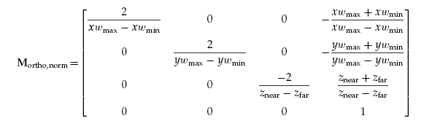
Clipping Window and Orthogonal-Projection View Volume
Normalization Transformation for an Orthogonal Projection

Slide 54
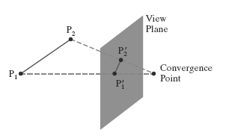
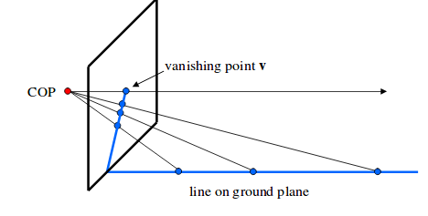
Perspective projection
In perspective projection, the distance from the center of projection to project plane is finite and the size of the object varies inversely with distance which looks more realistic.
The distance and angles are not preserved and parallel lines do not remain parallel. Instead, they all converge at a single point called center of projection or projection reference point.

Slide 55
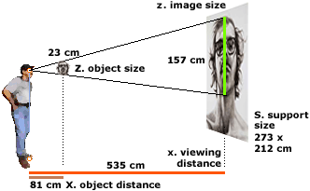
Perspective projection
Unlike a parallel projection, a perspective projection does not preserve relative proportions of objects.
Example : Photographic lenses and the human eye
When an observer sees scenes in day-to-day life, the far away objects look smaller relative to closer objects.
This projection’s property can provide a knowledge about depth.
Thus, artists often employ perspective projection for drawing three-dimensional sceneries.

Slide 56
Perspective projection
Two important characteristics -Perspective foreshortening
- Vanishing points
Perspective foreshortening: Due to foreshortening, lengths and objects seem small from the center of projection.
The more an artist increases the distance from the projection’s center, the small will be the appearance of the object.

Slide 57
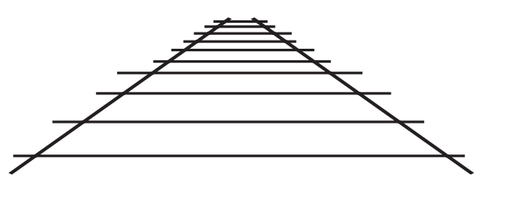
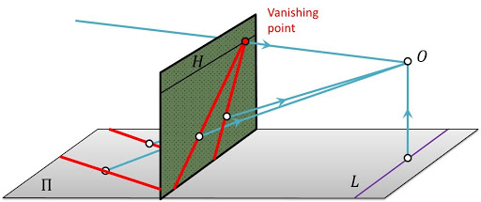
Perspective projection
Vanishing point: Vanishing point is considered as a side effect of the perspective projection.
Parallel lines that are not parallel to the viewing plane, converge to a vanishing point.

Slide 58
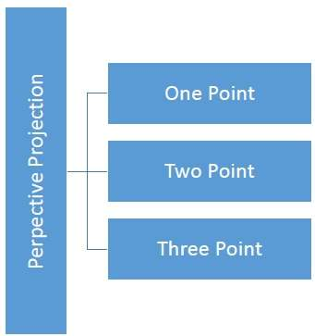
Perspective projection
Based on the number of vanishing points, the perspective projection is of three types
Single-point perspective projection
Double-point perspective projection
Triple-point perspective projection

Slide 59
Perspective-Projection Transformation Coordinates
One-point
In single-point perspective projection, there will be only one vanishing point.

Slide 60
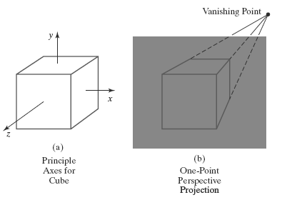
Perspective-Projection Transformation Coordinates
One-point
When the cube is projected to a view plane that intersects only the z axis, a single vanishing point in the z direction

Slide 61
Perspective-Projection Transformation Coordinates
Two-point
In double-point perspective projection, there will be a couple of vanishing points.
The first vanishing point will be in the direction of “x”.
The second vanishing point will be in the direction of “y”.

Slide 62
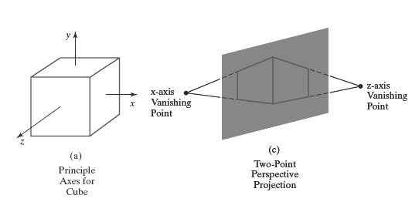
Perspective-Projection Transformation Coordinates
Two-point
When the cube is projected to a view plane that
intersects both the z and x axes, two vanishing points are produced.

Slide 63
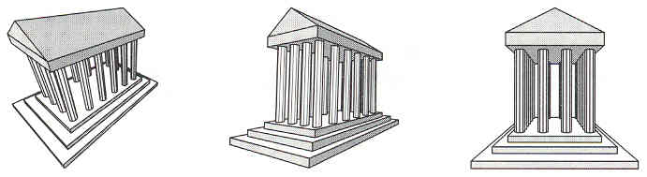
Perspective Projection
How many vanishing point?

Slide 64
Perspective Projection
How many vanishing point?
Three-point perspective

Slide 65
Perspective Projection
How many vanishing point?
Three-point perspective
Two-point perspective

Slide 66
Perspective Projection
How many vanishing point?
Three-point perspective
Two-point perspective
One-point perspective

Slide 67

Perspective-Projection Transformation Coordinates

Slide 68



Perspective-Projection Transformation Coordinates

Slide 69


Perspective-Projection Transformation Coordinates

Slide 70

Perspective Projection View Volume
A perspective-projection view volume is often referred to as a pyramid of vision because
it approximates the cone of vision of our eyes or a camera.

Slide 71

OpenGL General Perspective-Projection Function
glFrustum (xwmin, xwmax, ywmin, ywmax, dnear, dfar);
glFrustum describes a perspective matrix that produces a perspective projection.

Slide 72

Perspective-Projection Transformation Matrix
3D homogeneous-coordinate representation is used to express the perspective-projection equations in the form

Slide 73


Perspective-Projection Transformation Matrix
The perspective-projection transformation of a viewing-coordinate position is then accomplished in two steps.
First, calculate the homogeneous coordinates using the perspective-transformation matrix:
Where,
P_{h} is the column-matrix representation of the homogeneous point (x_{h}, y_{h}, z_{h}, h)
P is the column-matrix representation of the coordinate position (x, y, z, 1).

Slide 74
Perspective-Projection Transformation Matrix
2. Second, after other processes have been applied, such as the normalization transformation and clipping routines, homogeneous coordinates are divided by parameter h to obtain the true transformation-coordinate positions.

Slide 75
Perspective-Projection Frustum
Symmetric Perspective-Projection Frustum
Oblique Perspective-Projection Frustum

Slide 76

Symmetric Perspective-Projection Frustum
The line from the projection reference point through the center of the clipping window and on through the view volume is the centerline for a perspective projection frustum.
If this centerline is perpendicular to the view plane, we have a symmetric frustum

Slide 77
Symmetric Perspective-Projection Frustum
Frustum centerline intersects the view plane at the coordinate location
(x_{prp}, y_{prp}, z_{vp}),
we can express the corner positions for the clipping window in terms of the window dimensions

Slide 78

Symmetric Perspective-Projection Frustum
we can express the corner positions for the clipping window in terms of the window dimensions

Slide 79

Oblique Perspective-Projection Frustum
If the centerline of a perspective-projection view volume is not perpendicular to the view plane, we have an oblique frustum

Slide 80


Oblique Perspective-Projection Frustum
So first transform the view volume to a symmetric frustum and then to a normalized view volume.
An oblique perspective-projection view volume can be converted to a symmetric frustum by applying a z-axis shearing-transformation matrix.

Slide 81

Oblique Perspective-Projection Frustum
Similarly, with the projection reference point at the viewing-coordinate origin and with the near clipping plane as the view plane, the perspective-projection matrix is simplified to

Slide 82

Oblique Perspective-Projection Frustum

Slide 83

Normalized Perspective-Projection Transformation Coordinates
The final step in the perspective transformation process is to map this parallelepiped to a normalized view volume.

Slide 84



Normalized Perspective-Projection Transformation Coordinates

Slide 85
Perspective vs. Parallel Projection
Perspective projection
+ Size varies inversely with distance – looks realistic
– Distance and angles are not(in general) preserved
– Parallel line do not (in general) remain parallel
Parallel projection
+ Good for exact measurements
+ Parallel lines remain parallel
– Angles are not (in general) preserved
– Less realistic looking

Slide 86

The Viewport Transformation and Three-Dimensional Screen Coordinates
Once we have completed the transformation to normalized projection coordinates, clipping can be applied efficiently to the symmetric cube then the contents of the normalized view volume can be transferred to screen coordinates.

Slide 87

OpenGL Three-Dimensional Viewing Functions
OpenGL Viewing-Transformation Function
gluLookAt Function
The gluLookAt function provides an alternative to glTranslatef and glRotatef sequences for positioning the camera.
define a viewing transformation

Slide 88

OpenGL Three-Dimensional Viewing Functions
OpenGL General Perspective-Projection Function
glFrustum (xwmin, xwmax, ywmin, ywmax, dnear, dfar);
glFrustum describes a perspective matrix that produces a perspective projection.

Slide 89

OpenGL Three-Dimensional Viewing Functions
OpenGL Viewports and Display Windows
Viewport
The sub-window into which the current graphics are being drawn.
glViewport(x, y, width, height)
x, y - Specify the lower left corner of the viewport rectangle, in pixels. The initial value is (0,0).
width, height -Specify the width and height of the viewport.

Slide 90
Outline – Module 4
3DViewing
3D viewing concepts
3D viewing pipeline
3D viewing coordinate parameters
Transformation from world to viewing coordinates
Projection transformation
orthogonal projections
perspective projections
The viewport transformation and 3D screen coordinates
OpenGL 3D viewing functions
Visible Surface Detection Methods:
Classification of visible surface Detection algorithms,
back face detection
Depth buffer method
OpenGL visibility detection functions.

Slide 91

What are visible and hidden surface

Slide 92
Introduction
Computer graphics – How to determine what is visible within a scene from a chosen viewing position.
Numerous algorithms exist to identify and display of visible objects, these algorithms are called visible surface detection / hidden surface elimination method.

Slide 93
Classification of visible surface Detection algorithms
We can broadly classify visible-surface detection algorithms according to whether they deal with the object definitions or with their projected images.
Object-space methods
Image-space methods

Slide 94
Classification of visible surface Detection algorithms
Object-space methods: compares objects and parts of objects to each other within the scene definition to determine which surfaces, as a whole, we should label as visible.
Image-space methods: visibility is decided point by point at each pixel position on the projection plane.

Slide 95


Object-space methods
Image -space methods
Apply these methods directly on Physical coordinate
Apply these methods directly on Viewport /Projection port coordinate

Slide 96

Object-space methods
Image -space methods
Object part compare-visibility
Line-display algorithm( Vector graphic system)
Geometrical relationship among objects
Geometrical calculations (Float type)
Example
Back face detection method
Point to point pixel compare –visibility
Line- surface algorithm( Raster scan system)
Final image concentrate
Pixel = 1000 *1000
Example
Depth buffer method

Slide 97
List of visible surface detection / hidden surface elimination methods.
Back-Face Detection
Depth-Buffer Method (Z-Buffer Method)
Scan-Line Method
Depth-Sort Method
Binary Space Partitioning
Area Subdivision Algorithms
Octree Methods

Slide 98
Back-Face Detection
This method is used to remove back face of any object.
This method is like a preprocessor that removes back face in all methods
A fast and simple object-space method for identifying the back faces of a object is based on the "inside-outside" tests.

Slide 99



Slide 100

Back-Face Detection
1. INSIDE and OUTSIDE TEST
A point (x, y, z) is "inside" a polygon surface with plane parameters A, B, C, and D, if When an inside point is along the line of sight to the surface, the polygon must be a back face
We know the polygon surface equation:
Ax + By + Cz + D < 0
Then the point is inside polygon surface, So it is back of the front face, can be eliminated

Slide 101
Back-Face Detection
2. Surface is Backface
Consider the normal vector N to a polygon surface, which has
Cartesian components (A, B, C).
V_{view} is a vector in the viewing direction from the eye ("camera")
position, a polygon surface is a back face if:
V_{view} ⋅ N > 0
V_{view} = ( 0,0, V_{z} ) and N = Ax + By + Cz
V_{view} ⋅ N = ( 0,0, V_{z} ) (Ax + By + Cz )
= V_{z} C ( If V_{z} = 1)
V_{view} ⋅ N = C

Slide 102
Back-Face Detection
Sign(C ) ≥ 0 🡪 Surface is back(invisible)
Sign(C ) < 0 🡪 Surface if front (visible)

Slide 103

Back-Face Detection
Limitations:
Used only for solid objects modeled as a polygon mesh.
Problematic for concave polyhedra.
e.g. partially hidden face will not be eliminated by Back-face removal.

Slide 104
Depth buffer method
Advantage
Always works and is simple to implement => used in hardware
Disadvantages
Large memory requirements

Slide 105
OpenGL Visibility-Detection Functions
OpenGL Polygon-Culling Functions
OpenGL Depth-Buffer Functions
OpenGL Wire-Frame Surface-Visibility Methods
OpenGL Depth-Cueing Function

Slide 106
OpenGL Visibility-Detection Functions
OpenGL Polygon-Culling Functions
Back-face removal is accomplished with the functions
glEnable (GL_CULL_FACE);
glCullFace (mode);
where parameter mode is assigned the value GL_BACK,
GL_FRONT
GL_FRONT_AND_BACK
By default, parameter mode in the glCullFace function has the value GL_BACK
The culling routine is turned off with
glDisable (GL_CULL_FACE);

Slide 107
OpenGL Visibility-Detection Functions
OpenGL Depth-Buffer Functions
To use the OpenGL depth-buffer visibility-detection routines, we first need to modify the
GL Utility Toolkit (GLUT) initialization function for the display mode to include a request for the depth buffer, as well as for the refresh buffer
glutInitDisplayMode (GLUT_SINGLE | GLUT_RGB | GLUT_DEPTH);

Slide 108
OpenGL Visibility-Detection Functions
OpenGL Depth-Buffer Functions
Depth buffer values can then be initialized with
glClear (GL_DEPTH_BUFFER_BIT);
the preceding initialization sets all depth-buffer values to the maximum value 1.0 by default
The OpenGL depth-buffer visibility-detection routines are activated with the following function:
glEnable (GL_DEPTH_TEST);
And we deactivate the depth-buffer routines with
glDisable (GL_DEPTH_TEST);

Slide 109
OpenGL Visibility-Detection Functions
OpenGL Depth-Buffer Functions
We can also apply depth-buffer visibility testing using some other initial value for themaximumdepth, and this initial value is chosen with theOpenGLfunction:
glClearDepth (maxDepth);
Parameter maxDepth can be set to any value between 0.0 and 1.0.
Projection coordinates in OpenGL are normalized to the range from −1.0 to 1.0, and the depth values between the near and far clipping planes are further normalized to the range from 0.0 to 1.0.

Slide 110
OpenGL Visibility-Detection Functions
OpenGL Depth-Buffer Functions
As an option, we can adjust these normalization values with
glDepthRange (nearNormDepth, farNormDepth);
By default, nearNormDepth = 0.0 and
farNormDepth = 1.0.
But with the glDepthRange function, we can set these two parameters to any values within the range from 0.0 to 1.0

Slide 111
OpenGL Visibility-Detection Functions
OpenGL Depth-Buffer Functions
Another option available in OpenGL is the test condition that is to be used for the depthbuffer routines.
We specify a test condition with the following function:
glDepthFunc (testCondition);
Parameter testCondition can be assigned any one of the following eight symbolic constants:
GL_LESS, GL_GREATER, GL_EQUAL, GL_NOTEQUAL,
GL_LEQUAL, GL_GEQUAL, GL_NEVER (no points are processed), and GL_ALWAYS.
The default value for parameter testCondition is GL_LESS.

Slide 112
OpenGL Visibility-Detection Functions
OpenGL Depth-Buffer Functions
We can also set the status of the depth buffer so that it is in a read-only state or in a readwrite
state.
glDepthMask (writeStatus);
When writeStatus = GL_TRUE (the default value), we can both read from and write to the depth buffer.
With writeStatus = GL_FALSE, the write mode for the depth buffer is disabled and we can retrieve values only for comparison in depth testing.

Slide 113
OpenGL Visibility-Detection Functions
OpenGL Wire-Frame Surface-Visibility Methods
A wire-frame display of a standard graphics object can be obtained in OpenGL by requesting that only its edges are to be generated.
We do this by setting the polygon-mode function as, for example:
glPolygonMode (GL_FRONT_AND_BACK, GL_LINE);

Slide 114
OpenGL Visibility-Detection Functions
OpenGL Depth-Cueing Function
We can vary the brightness of an object as a function of its distance from the viewing position with
glEnable (GL_FOG);
glFogi (GL_FOG_MODE, GL_ LINEAR);
This applies the linear depth function to object colors using dmin = 0.0 and dmax = 1.0.

Slide 115
OpenGL Visibility-Detection Functions
OpenGL Depth-Cueing Function
But we can set different values for dmin and dmax with the following function calls:
glFogf (GL_FOG_START, minDepth);
glFogf (GL_FOG_END, maxDepth);
parameters minDepth and maxDepth are assigned floating-point values, although integer values can be used if we change the function suffix to i.

